Slide 1
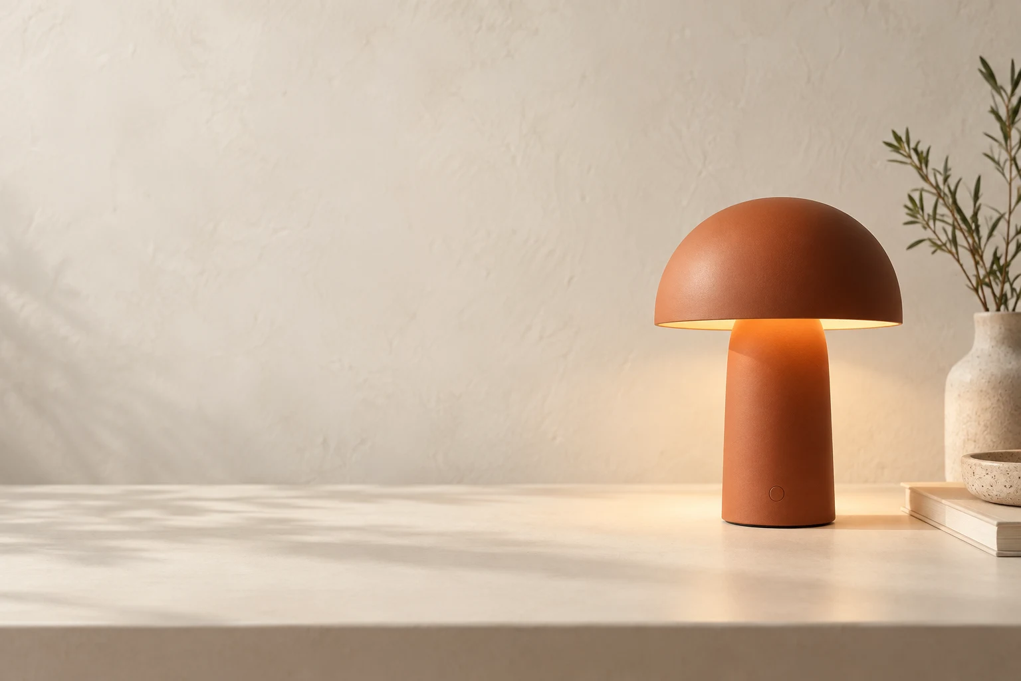
A little calm.
A clear direction.
A fictional desk-lamp campaign for a quieter home-office corner.
Terracotta · Ivory · Deliberate copy space
Notes:
Original teaching deck. The product image is an AI-generated editorial illustration, not a real product photograph or an Astra benchmark. Headings and body copy are editable. No product specifications are asserted.

Slide 2
One direction, three useful assets
Approve the image before creating motion or adapting the crop.
Asset | Layout requirement | Acceptance check
Website hero | Wide crop; subject right | Headline fits as live HTML
Social variation | Square crop; clear focal point | Product identity preserved
Motion opening | Approved still as input | Inspect the actual video export
Notes:
This asset table is native PowerPoint table content. Select and edit individual cells. The requirements are illustrative workflow decisions, not performance measurements.

Slide 3
Decisions before a real launch
Product facts
Commercial facts
Creative approval
Confirm dimensions, power, materials and approved claims.
Supply a real price, availability and action destination.
Choose the final crop, exact headline and export formats.
Notes:
These are unresolved decisions, not facts about a real product. Replace them with verified information before adapting this example for publication.

